Slide 2
What We Plan to Accomplish Today
Lay out objectives
Discuss partnership options
Review timeline and budget
Align to program KPIs

Slide 3
Objectives & Considerations
MARKETING OBJECTIVES
BUSINESS OBJECTIVES
#1 Increase awareness
#2 Drive trial among Everyday Enthusiasts
#3 Distinguish MXD from high ABV competitors
Increase volume sales (+71%) and PODS (+23K)
CONSUMER: Everyday Enthusiasts M21-29
CONSUMPTION (MEDIA): Overindex across all media; slightly lower on TV and digital than radio, print and OOH
CHANNEL: Primarily convenience store
COMPETITION: Clubtails is the current market leader; consider blunting tactics in strong markets
FOCUS: National launch
BUDGET: $100K
Notes:
Fame and Feeling – increase awareness and establish an emotional connection
Brand, Target, and occasion for sales team and distributors
Tier 1 or 2 enhance at home, Tier 3 let’s send them somewhere cool

Slide 4
KPIs
BUSINESS OBJECTIVES
INCREASE AWARENESS
DRIVE TRIAL
800K CE in Sales
Increase from 7% to 9%
Increase from 4% to 5%
Notes:
Natty Rush awareness – 10%
Clubtails awareness – 7%

Slide 5



GLORY
Why is it a brand fit? MXD and Glory’s brand promises align: both guarantee an epic night/experience.
What’s in it for the consumer? Everyday Enthusiast over index in watching boxing.
What’s in it for the retailer? Monster Energy is a Global GLORY partner, which will lend credibility to MXD’s partnership with Glory.
RETAIL
BRAND INTEGRATION
MEDIA
DISTRIBUTOR INCENTIVE
Usage rights for 2 GLORY athletes on POS
GLORY TTW
4 winners
Training session
Meet & greet
VIP tickets
Logo featured on:
Event marketing
Corner of the canvas
2 Toblerones around the ring
All step & repeats for weigh ins & press conferences
Product placement at press conferences
1 broadcast feature in 2020
Presenting partner for “Tail of the Tape” main event fight
Website homepage takeover during launch
3 posts on GLORY’s Facebook
3 custom video content pieces (up to :30)
3 video posts on GLORY’s Facebook, Instagram, and YouTube channels
Inclusion in GLORY digital ads
Digital & Social: 1MM guaranteed impressions
20 GLORY swag packs
2 winners & guest sent to 2020 GLORY event
BUDGET
$150,000
Notes:
Blue Jackets:
2017-18 650k total attendance
7 sampling events: 600-900 samples/each
Sponsorship increases to $120,750 in 2019-20

Slide 6
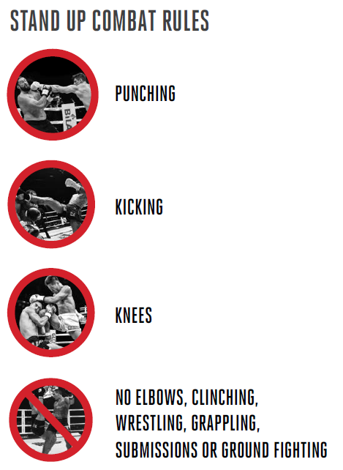
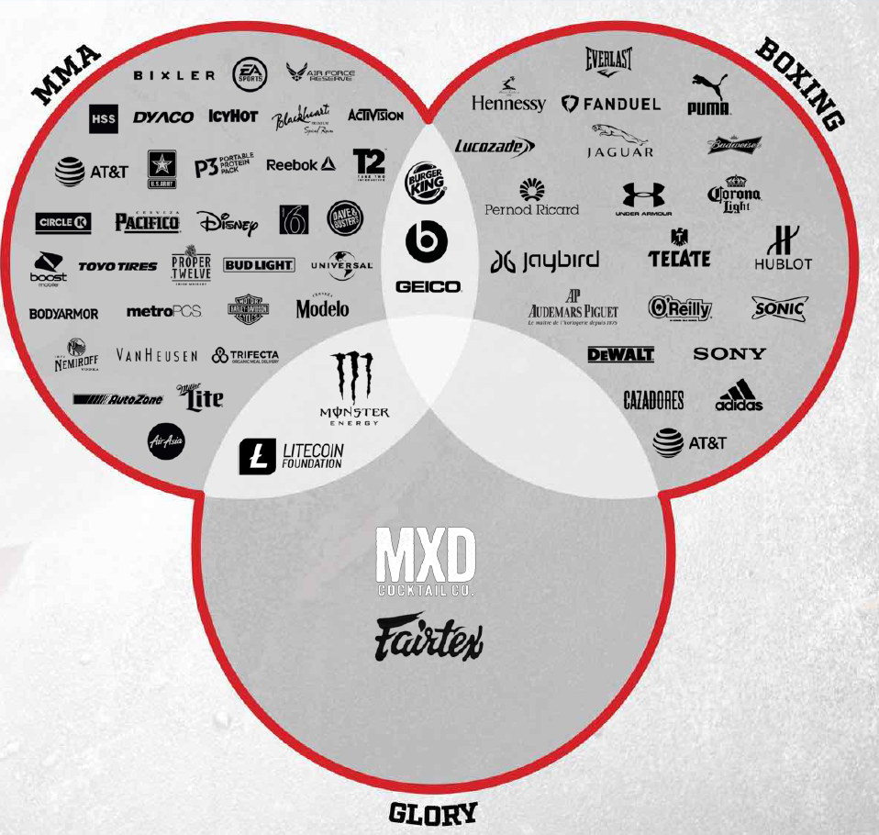
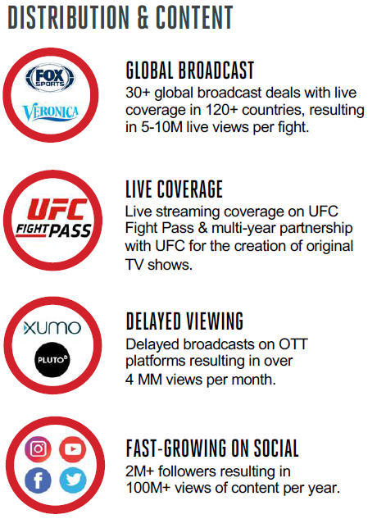
What is GLORY?

Slide 7
WWE
Why is it a brand fit? MXD and WWE’s brand promises align: both guarantee an epic experience.
What’s in it for the consumer? WWE fans over index in flavored alcohol consumption.
What’s in it for the retailer? 65% of WWE fans say advertising helps them choose to buy.
What’s included?
Impressions
Logo included in retail TTW program
Prize management
YouTube :15 targeted media
Digital, video, and mobile :15
5,000,000
Budget
$125,000

Slide 8
Fantasy Island
Why is it a brand fit? Aligns to MXD’s tropical look and feel. Fantasy Islands’ target are m/w 18-34.
What’s in it for the consumer? 71% of MXD audience has attended a movie in the last 6 months, and are more likely to choose horror.
What’s in it for the retailer? Leverages up-and-coming cinema property to excite consumers.
What’s included?*
Impressions
Logo included in retail TTW program
In-cinema media
Cinema takeovers
TBD
Budget
$250,000
*proposed

Slide 9
Side-by-Side
GLORY
WWE
Fantasy Island
Blue Jackets*
Logo at retail
Sampling
Branding inclusion
Media
Website
Digital
Social
1MM Impressions
Logo at retail
Media
Digital
5MM Impressions
Logo at retail
Media
In-cinema
Digital
Cinema takeovers
Logo at retail
Sampling
Branding inclusion
Media
Website
Digital
Social
$150,000
$125,000
$250,000
$115,000
*comparison only

